Slide 1
Computer Graphics Sessional CSI-414 Final Presentation
Presentation on:
OpenGl/GLUT based project presenting the scenery of a Lighthouse over the dockside

Slide 2
Team n&m
Members:
1. Fakrul Ibne Hassan
ID – CSE 066 07714
Batch – 66(C)
2. Mehedi Hassan
ID – CSE 066 07715
Batch – 66(C)

Slide 3
General Information
Subject: CSI 414 – CG sessional
Presentation Number: Final Presentation
Topic: OpenGL/GLUT based project presenting the
scenery of a Lighthouse over the dockside.
Presented to:
Mashiwat Tabassum Waishy
Senior Lecturer
Stamford University Bangladesh
Date of presentation: 5 September, 2021

Slide 4
Overview
Introduction
Details
Project Images
Function Descriptions
Conclusion

Slide 5
Introduction
For the final project of the course of Computer Graphics Sessional
we decided to attempt to create the scenery of a lighthouse that
was over-seeing a dockside.
The Lighthouse was planned to be shown on top of a hill. The hill
would loom over a busy dockside. The dockside would be busy as
ever with the movements of the people and the coming and going of
ships.
The sky would be cloudy and in the horizon we could see the
Mountain range. There would be boats moving in the background in
the distance.

Slide 6
Details
The project is created using OpenGL/Glut using the C
language.
The project is created using the 2d convention and using a
single buffered window and following RGB color convention.
The project includes the following features:
Movable objects in the foreground.
Automatically moving ships in the background.
Moving clouds in the sky.
Characters exchanging dialogue
Shops with color changing signs

Slide 7
Details
Light house on the hill
Changing light color of the light house
A dockside
Removable ladder connecting the dock to the ship
Most these can be seen through the use of keyboard functions.
The list of the keyboard functions and images showcasing the finished state of the project are included next.

Slide 8
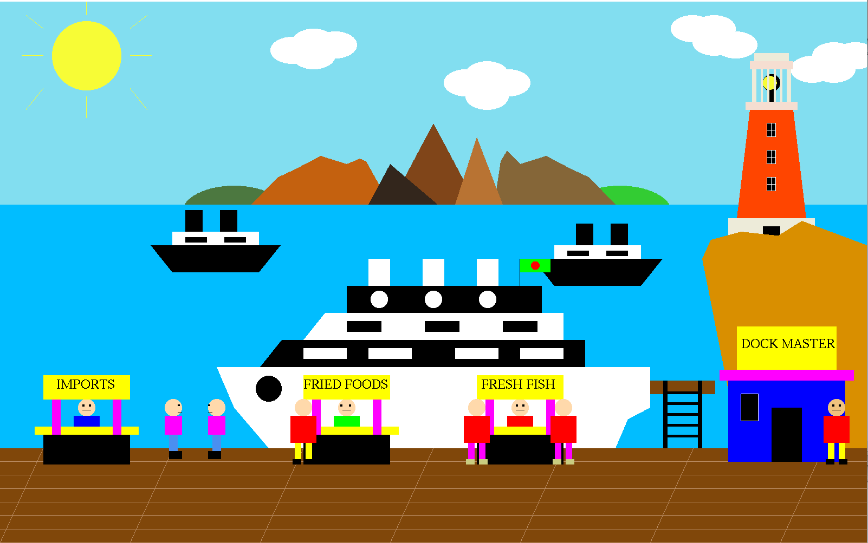
PROJECT IMAGES

Slide 9
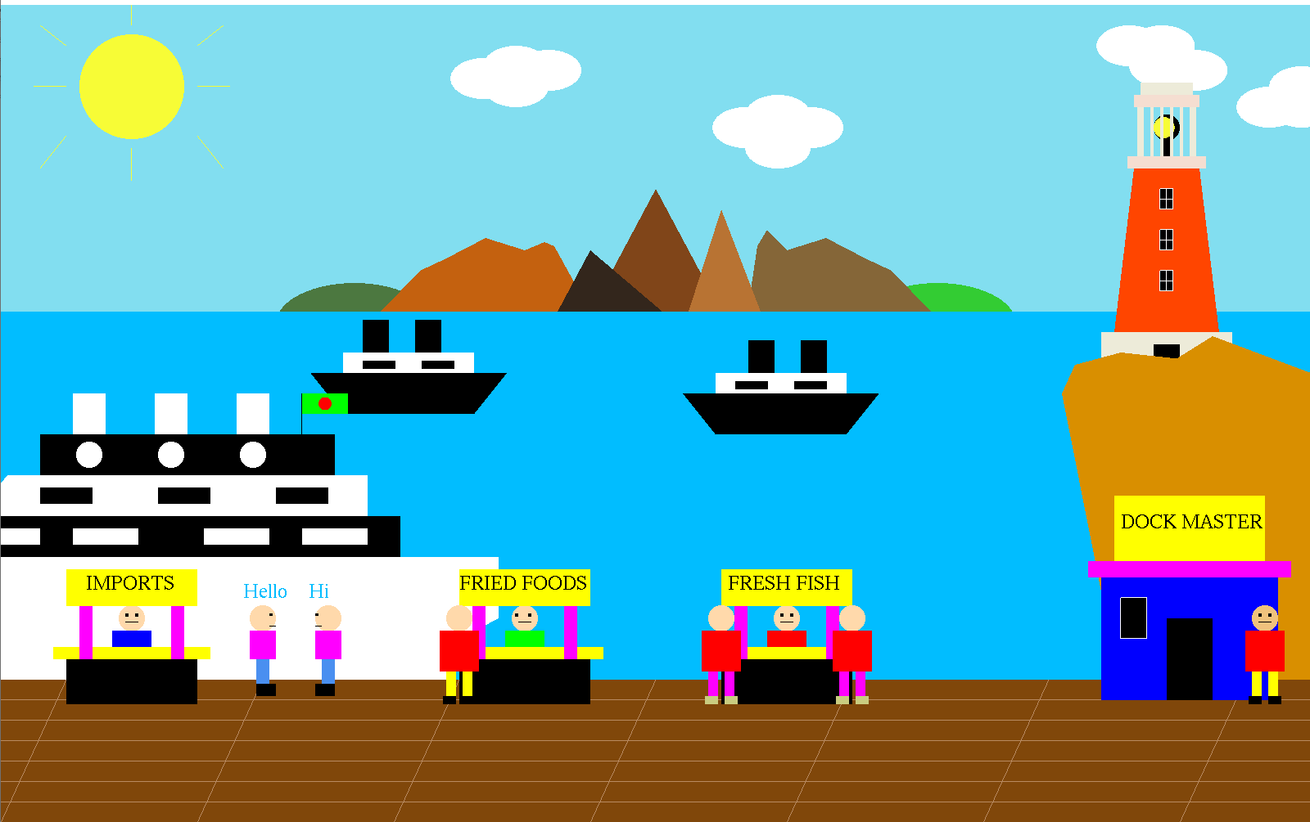
PROJECT IMAGES

Slide 10
Function Descriptions
Q – Change Lighthouse light color to red
W - Change Lighthouse light color to default
E – Move the light to the right
R – move the light to the left
T – Change the sign color to default
Y – Sign color change 1
U – Sign color change 2
I – Sign color change 3
O – Move ship forward
P – Move ship back
A – Light 1 to default
S – light 2 to default
D – Light 3 to deafault

Slide 11
Function Descriptions
F- light 1 to yellow
G – Light 2 to yellow
H – Light 3 to yellow
J – Ladder default
K – Ladder 2 default
L – Remove ladder 1
Z – Remove ladder 2
X – NPC 1 dialogue
C – NPC 1 dialogue remove
V – NPC 2 dialogue
B – NPC 2 dialogue remove
M - IdleFunction

Slide 12
Conclusion
With this I conclude our presentation.
Thanks to everyone for listening.

